Slide 1


TRAVEL AGENCY MANAGMENT SYSTERM
M22W7547
Tashmika Isuri

Slide 2

Agenda
PURPOSE OF TAMS
Describe Output
Class Creation
Class Description
Data Store
Reference

Slide 3


PURPOSE OF TAMS
•Travel agencies, their employees, and customers will benefit from the improved efficiency, personalized service, and real-time insights provided by the TAMS.
Automate administrative tasks.
Enhance customer experience.
Improve operational efficiency.
Provide data-driven insights.
Ensure security and compliance.

Slide 4
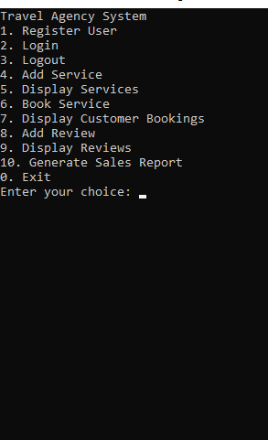
MY TARGET OUTPUT IS TO DESIGN A PROGRAM WHICH CAN WORKING WITH FOLLOWING HR FUNCTIONS.
Add Service
Display Services
1. Luxury Hotel (Hotel) - $200
2. Economy Car Rental (Car Rental) - $50
3. City Tour (Tour Package) - $100
Book Service
Display Customer Bookings
Add Review
Display Reviews
Generate Sales Report

Slide 5
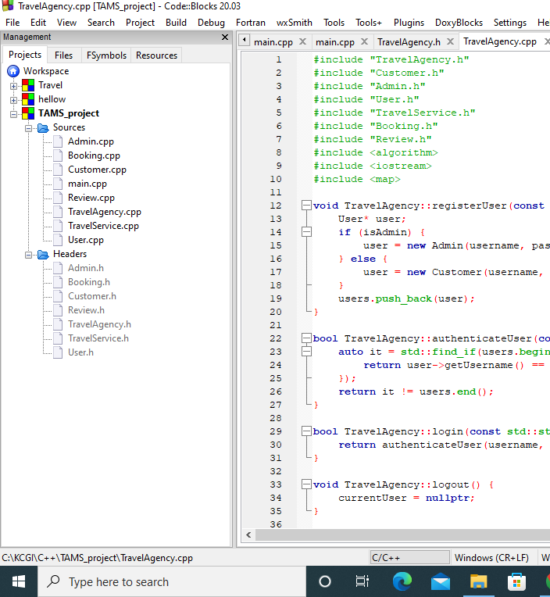
CLASS CREATION
When we design a program as a project, we have to create two separate files for each classes.
1
In “.h” file we only declare variables, constructors and methods.
2
In “.cpp” file we have to define constructors and methods which are declare in the “.h” file.

Slide 6
CLASS DESCRIPTION
1 TravelAgency
Manages overall system functionalities, including user registration, authentication, service management, and bookings.
.2 User
Base class for user management with common attributes and methods.
3 Customer
: Extends User to include customer-specific functionalities, such as managing bookings and reviews.
4 Admin
Extends User to include admin-specific functionalities, such as managing services and generating reports.
5 TravelService
Base class for different travel services, including hotels, car rentals, and tour packages.
6 Booking
: Manages booking details, including customer, service, date, total price, and payment status.
7 Review
Handles customer reviews and ratings for services.

Slide 7
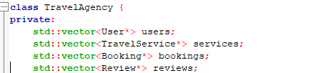
Arrays for data storing.
Here I creates four arrays to temporary store the data

Slide 8

Conclusion
TAMS is a comprehensive solution designed to improve the efficiency and customer satisfaction of travel agencies. By automating tasks, organizing information, and providing valuable insights, TAMS helps agencies operate more effectively. As technology continues to evolve, TAMS will be able to integrate even more advanced features, such as AI, VR, and blockchain technology.

Slide 9

reference
Classes and Function Creation
Lecture notes
W3school.com
How to design C++ Project
You tube Tutorials
Error Handling
ChatGPT
Gemini

Slide 10

Q & A ?

Slide 11

Thank You !.

